Slide 1


CWCT 140
Professor David Lieberman
dlieberman@ivytech.edu

Slide 2
Agenda
Functions - Parameter Passing
None type
Scope of Variables
Recursion
Dictionaries
Exceptions

Slide 3

Functions – Positional Parameters
def my_function(a, b, c):
print(a, b, c)
my_function(1, 2, 3)
my_function(3, 2, 1)

Slide 4

Functions – Keyword Arguments
def my_function(a, b, c):
print(a, b, c)
my_function(a=1, b=2, c=3)
my_function(c=3, b=2, a=1)

Slide 5

Functions – None Keyword
def my_function():
pass
Result = my_function()
print(Result)
if Result == None:
print("Yup, got None")

Slide 6

Functions – Returning Valid Result
def is_even(n):
if(n % 2 == 0):
return True
# Will we see a true and false?
print(is_even(0))
print(is_even(1))

Slide 7

Functions – Returning Valid Result
def is_even(n):
return (n % 2 == 0)
# Will we see a true and false?
print(is_even(0))
print(is_even(1))

Slide 8
Functions – Scope of Variables
def scope_test():
print("myVar = ", myVar)
myVar = 88
scope_test()
This is really bad program design

Slide 9

Functions – Scope of Variables
def scope_test():
x = 123
scope_test()
print(x)
x is “local” to the function

Slide 10
Functions – Scope of Variables
def scope_test():
x = 123
return x
print(scope_test())
Way better program design

Slide 11
Functions – global Keyword
def scope_test():
global x
x = 123
scope_test()
print(x)
NEVER use “global” keyword
You are just asking for trouble!

Slide 12
Functions – Recursive
def factorial(n):
if n < 0:
return None
if n < 2:
return 1
return n * factorial (n - 1)
Example: 6! = 6 * 5 * 4 * 3 * 2 * 1

Slide 13
Functions – Recursive
def factorial(n):
if n < 0:
return None
if n < 2:
print("1 = ", end="")
return 1
print(n, "* ", end="")
return n * factorial(n - 1)
print(factorial(5))

Slide 14
Python List Types
list – (mutable) can be changed
tuple – (immutable) cannot be changed
dictionary – consists of key/value pairs. Keys must be unique. Values can be changed.

Slide 15
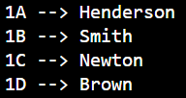
Python Dictionary
myApts = \
{
"1A": "Henderson", "1B":"Smith", "1C":"Newton", "1D":"Brown"
}
for key in myApts.keys():
print(key, "-->", myApts[key])

Slide 16

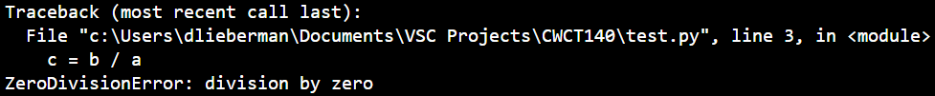
Python Exceptions
a = 5 #or 0
b = 10
c = b / a
print(c)
print("End of program")

Slide 17

Python Exceptions
a = 0
b = 10
try:
c = b / a
print(c)
except:
print("Program Error")
print("End of program")

Slide 18

Python Exceptions
a = 0
b = 10
try:
c = b / a
print(c)
except Exception as e:
print(e)
print("End of program")

Slide 19

Python Exceptions
a = 0
b = 10
try:
c = b / a
print(c)
except ValueError:
print("Error in value")
except ZeroDivisionError:
print("Error in division")
print("End of program")

Slide 20
Programming Assignment
With all program submissions you need to include screenshots illustrating your programs ran successfully.
All program submissions require a header comment containing your name, course, date, program name, and a description of the program.

Slide 21
Assignment #1
Write a function named fallingDistance that accepts an object’s falling time (in seconds) as an argument
return the distance, in meters, that the object has fallen during that time interval
From Main, call the function in a loop that passes the time values in 5 second increments
Table output should have a header identifying the column names and tabular formatted values

